Slide 1
Excel Final Assessment
4261 Akshansh Agarwal

Slide 2
Q1
No duplicate values found
There are no significant/important columns with null values other than comments. As most of the videos do have their comments disabled.

Slide 3
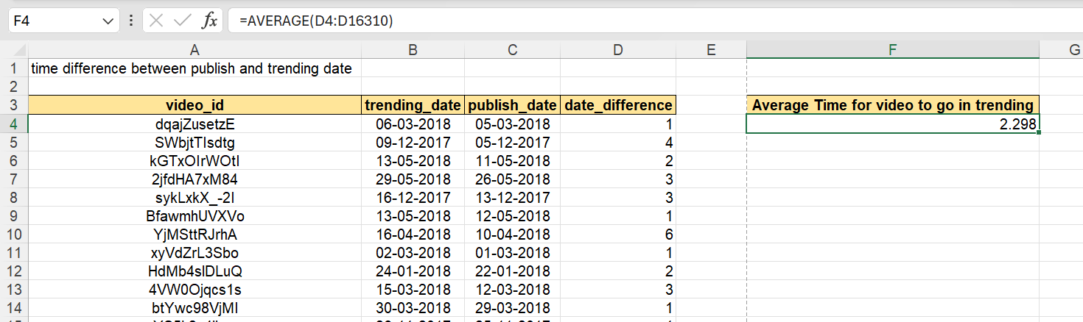
Q2
We came to know that average time for a video to go in trending is
2.298 DAYS

Slide 4
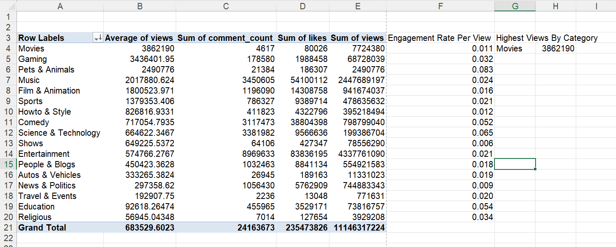
q3
Used pivot table
Found Out that Movies does have the highest view count
Also found out the engagement rate for each category

Slide 5
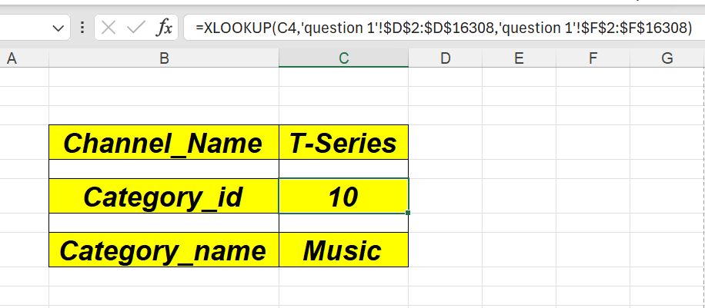
Q4
Used XLOOKUP to find Category_id and Category_Name

Slide 6
Q5
Used FILTER function with TEXTJOIN
=TEXTJOIN(",",TRUE,FILTER($Q$1:$Q$16308,R2:R16308=R2))

Slide 7
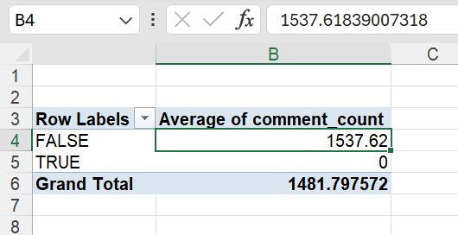
Q6
Videos with comments disables wont be having any comments

Slide 8
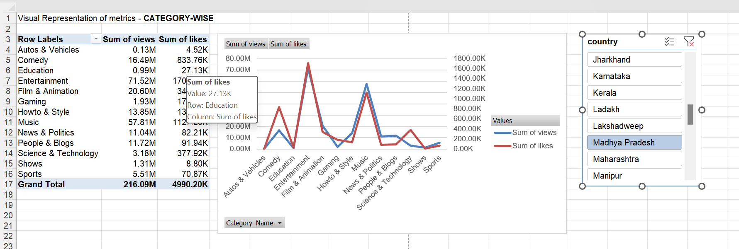
Q7
Used Pivot Table to analyze category wise date on sum of views and sum of likes
Used Combo Chart with Secondary Axis
Used slicer to filter data state-wise

Slide 9
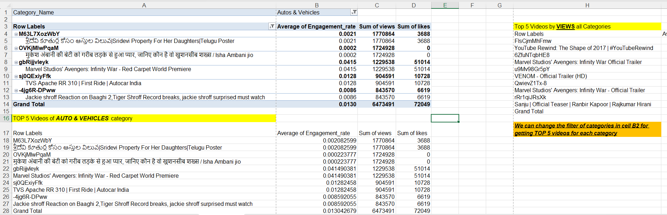
Q8

Slide 10
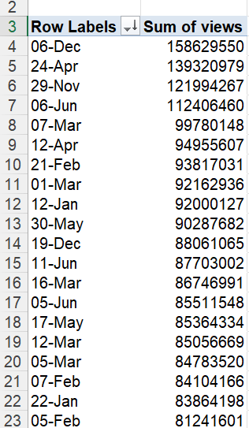
Q9
Used pivot tavble to find out on which day(date) had maximum views
The presented screenshot is sorted by sum of views (High to low) with respect to Day

Slide 11
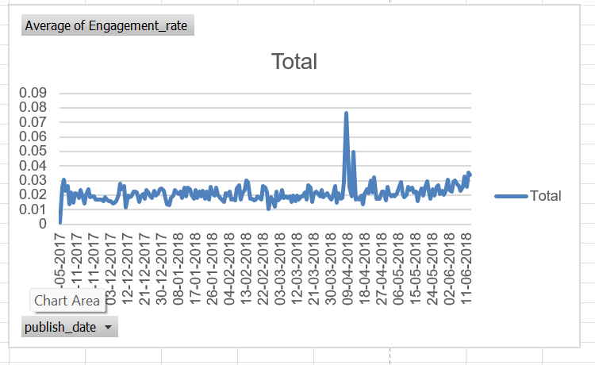
Q11
Day on day retention rate

Slide 12
Q12
We will be using FORECAST function

Slide 13
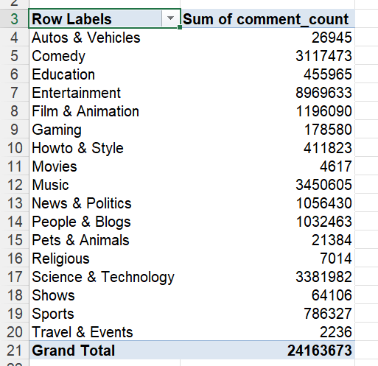
Q13

Slide 14
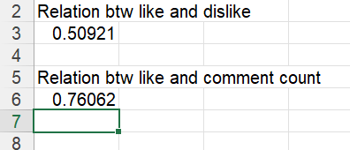
Q15

Slide 15
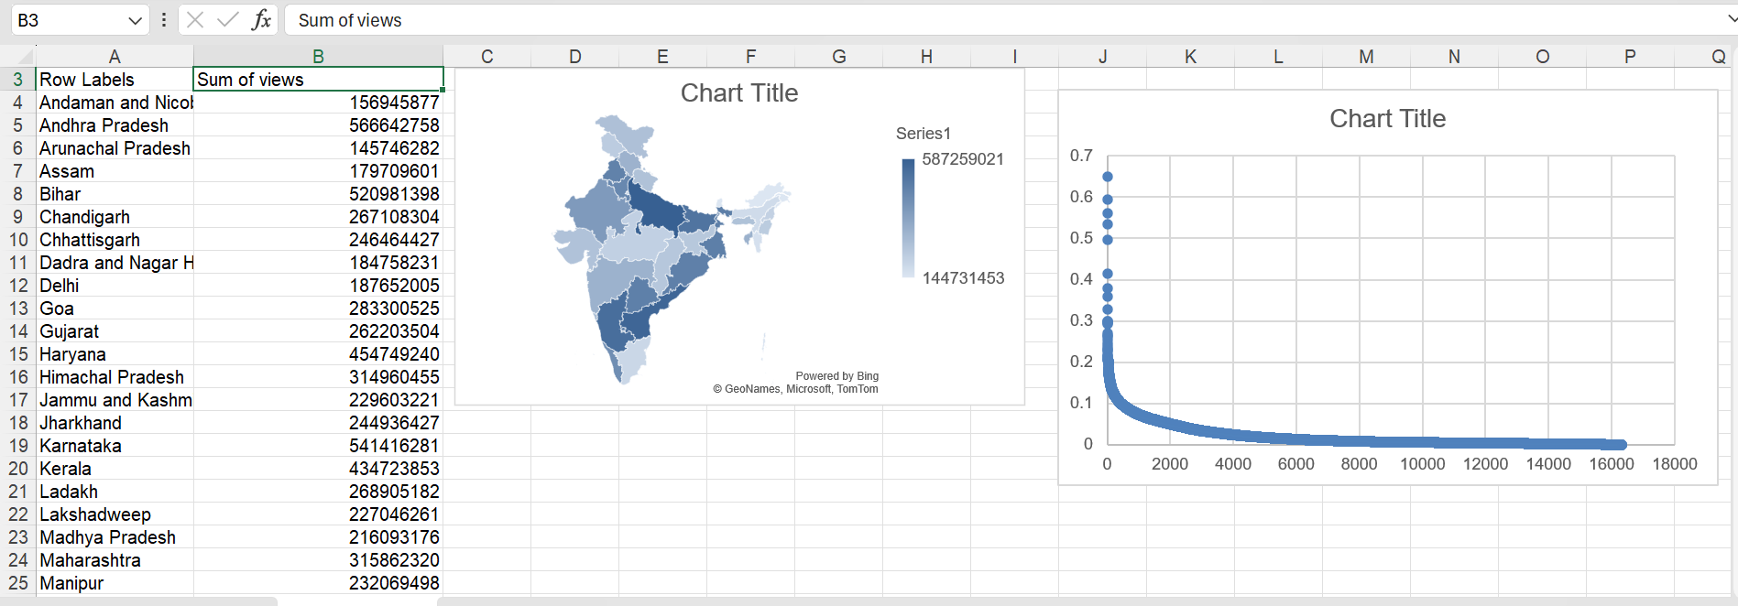
Q16-17

Slide 16
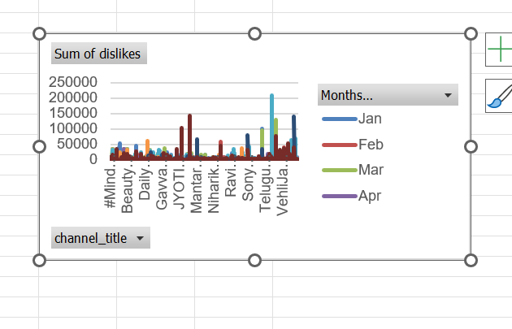
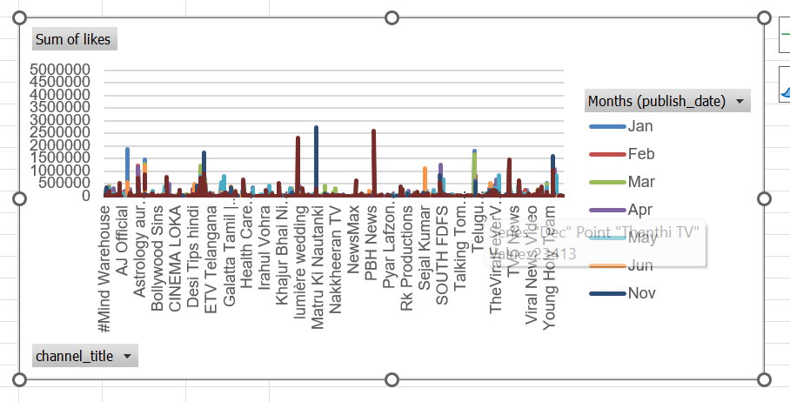
Q18

Slide 17
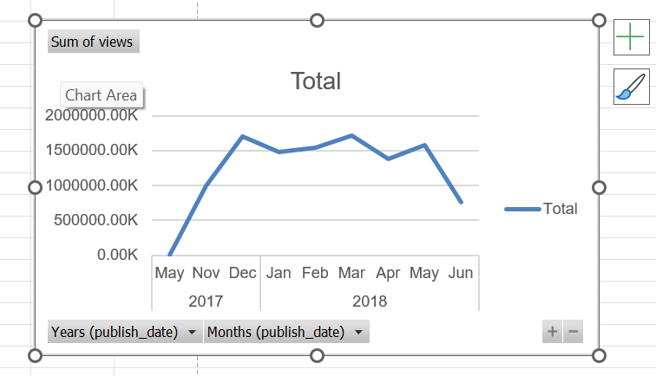
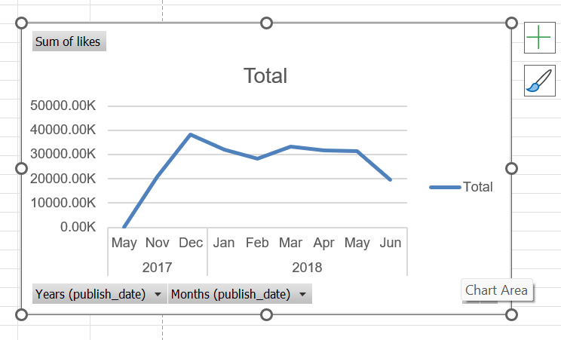
Q19
Month on month views
Month on month likes

Slide 18
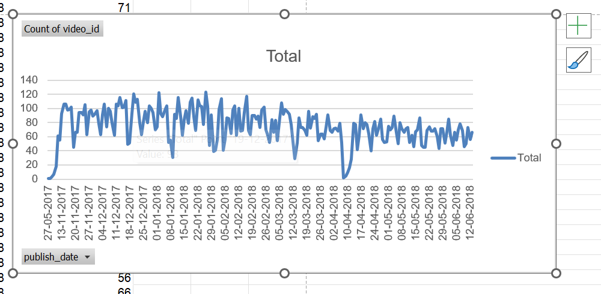
Q20
Day on Day video count

